Slide 1
HashStegoVault
Supervised by,​
Mohammed Shafiul Alam Khan​
Professor,​
IIT, University of Dhaka
​
Presented by,
Adnan Bin Wahid
BSSE-14
Roll:- 1442

Slide 2
Aim of the project:
Enhance digital security and privacy by offering a user-friendly, efficient, and reliable solution
Hiding sensitive information within images while ensuring data integrity through hashing.
Combining LSB steganography with the SHA-512 hashing algorithm
Safeguarding digital communications and data, addressing both confidentiality and data integrity concern

Slide 3

Motivation:
Secure Data Transmission: Safely send confidential messages within images.
Data Privacy Protection: Guard data from unauthorized access and surveillance.
Data Integrity Verification: Confirm the authenticity and integrity of hidden data.
Privacy Assurance: Provide users with an extra layer of privacy for their data.

Slide 4
The Least Significant Bit (LSB) method
The well-known strategy that is utilized for steganography
Utilize LSB of picture‘s pixel data

Slide 5
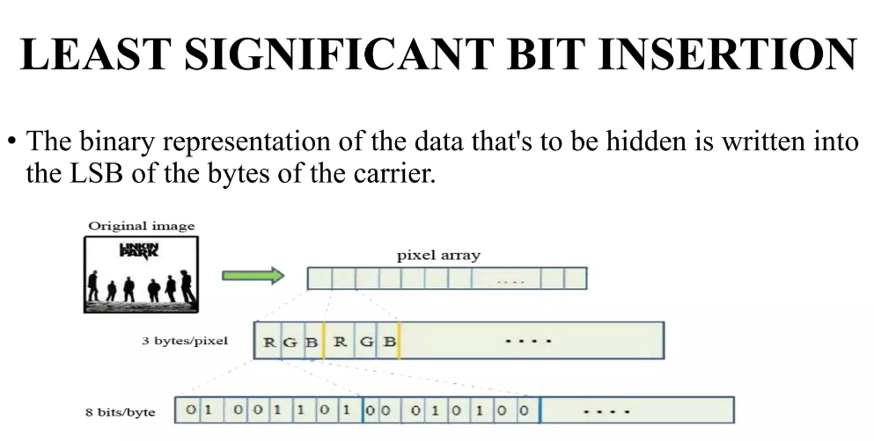

Slide 6
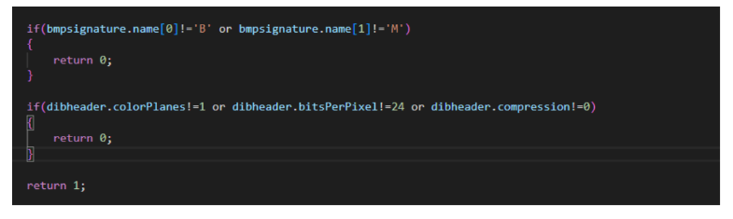
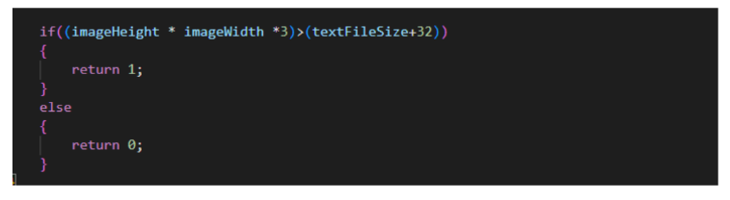
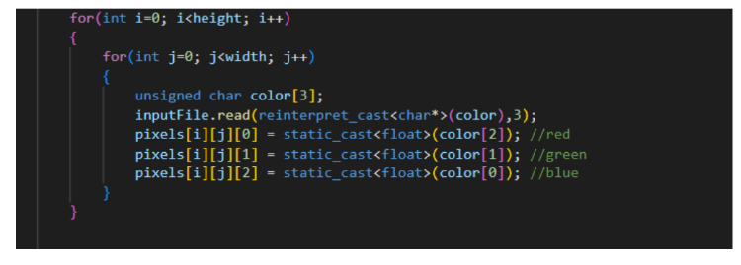
Checking image file, checking text size , extracting pixel values

Slide 7
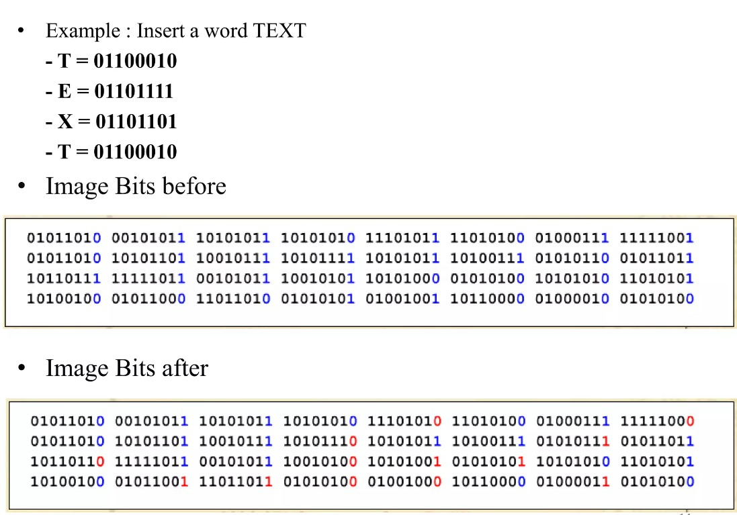

Slide 8
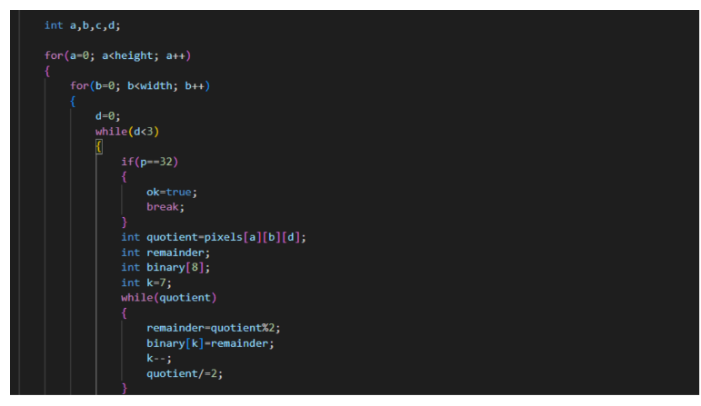
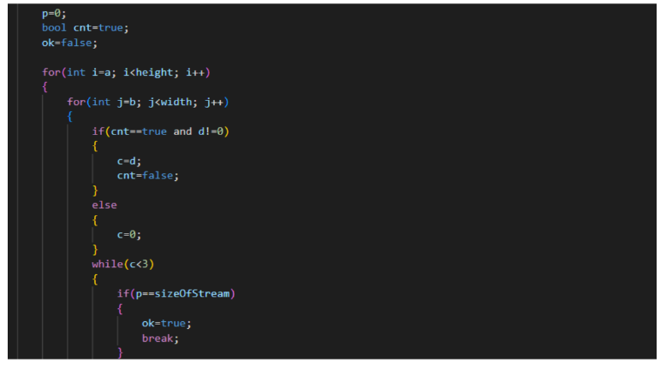
Embedding message length and message

Slide 9
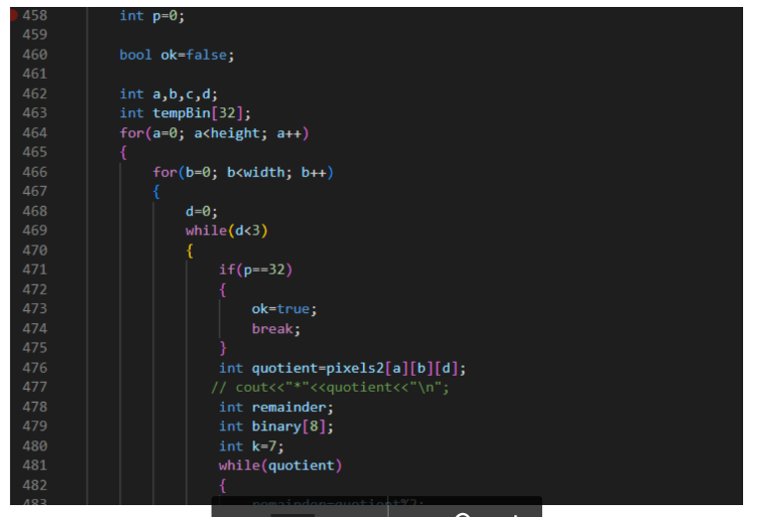
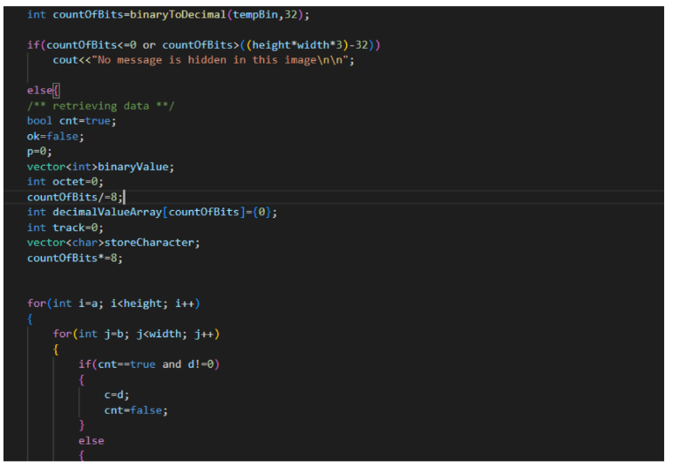
Reading size of the message and retrieving the data

Slide 10
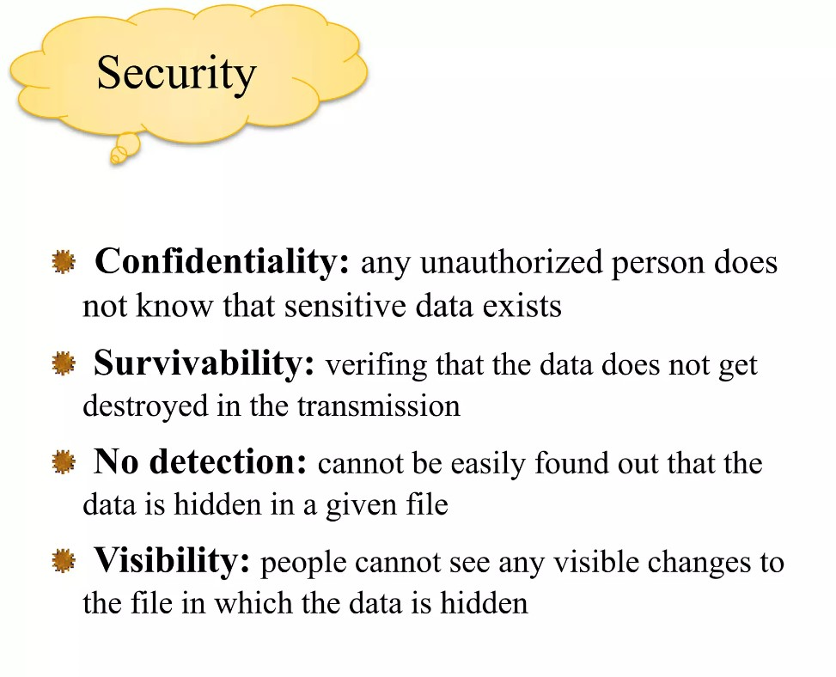

Slide 11
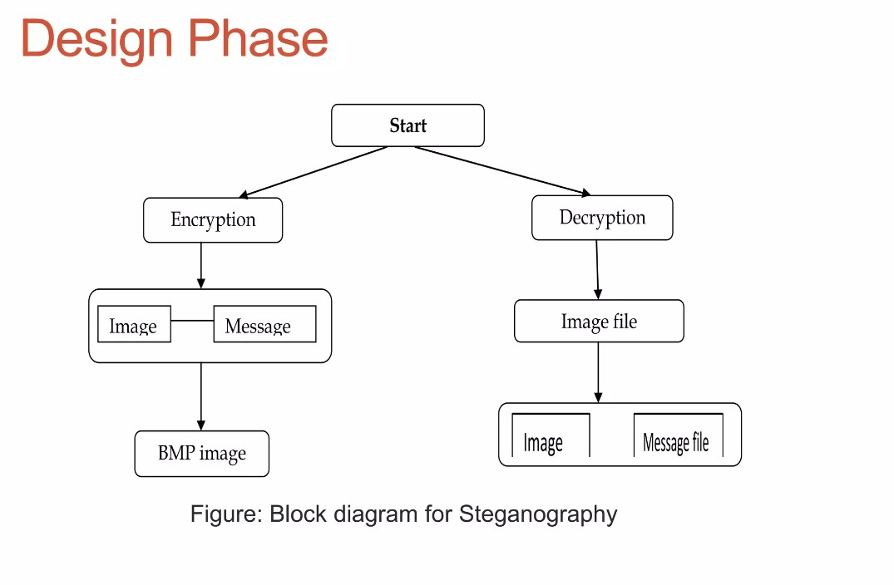

Slide 12
SHA-512
Hashing functions take some data as input and produce an output (called hash digest) of fixed length for that input data.
SHA-512 is a hashing algorithm that performs a hashing function on some data given to it.

Slide 13
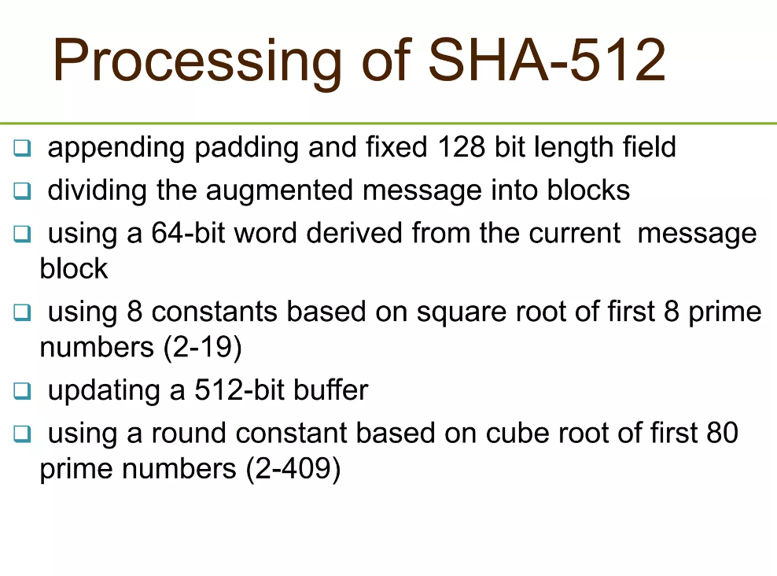

Slide 14
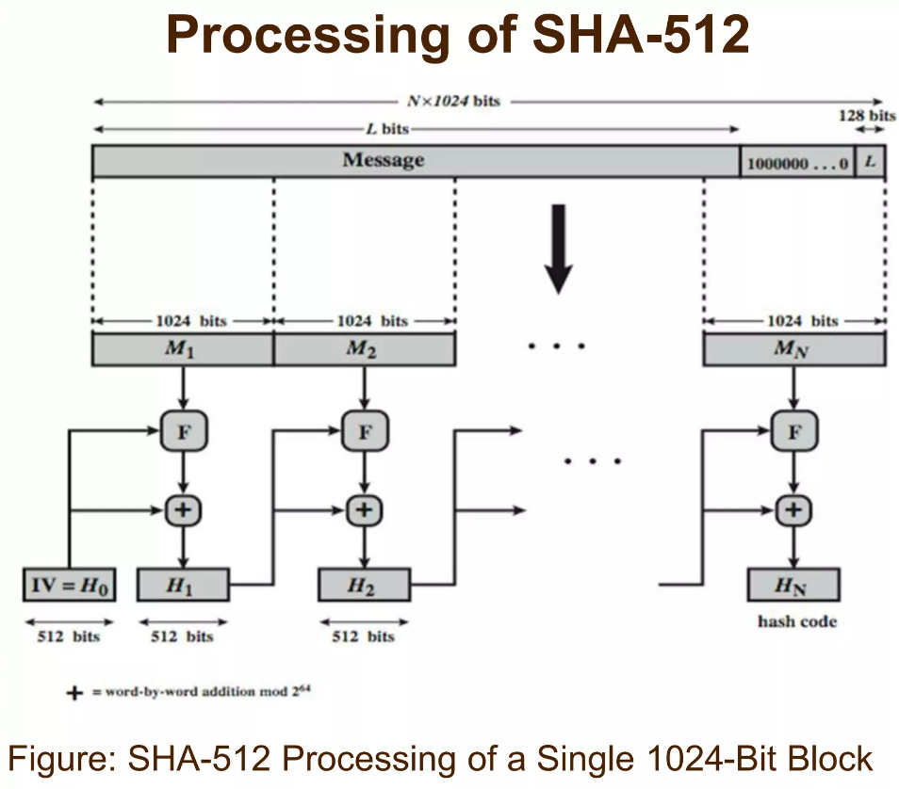

Slide 15
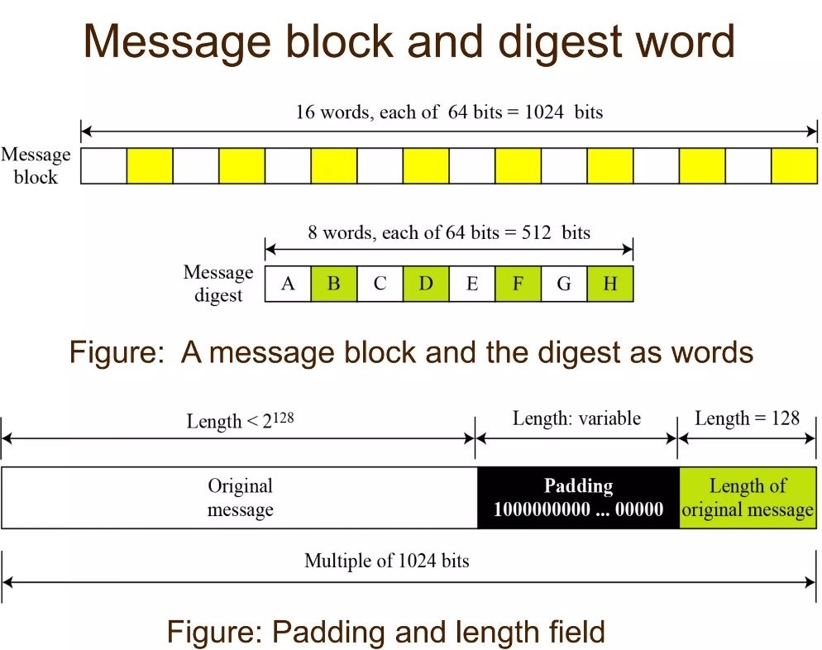

Slide 16
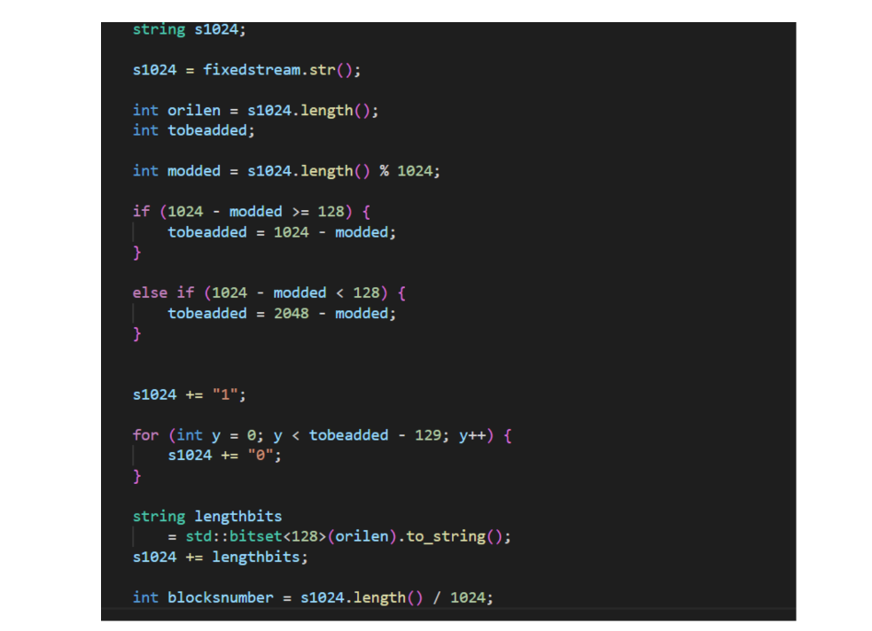

Slide 17
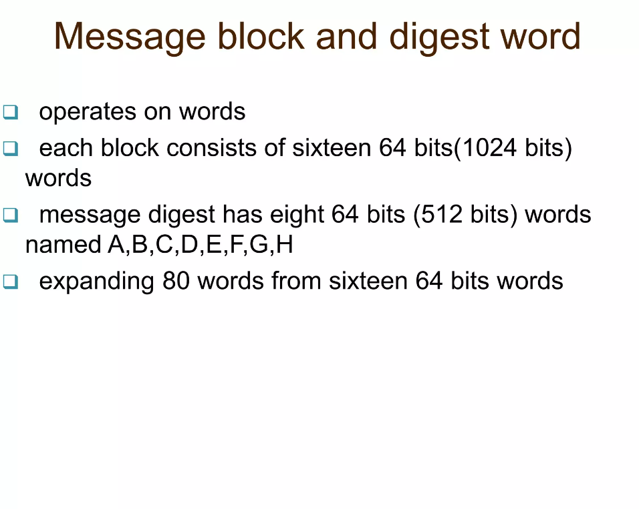

Slide 18
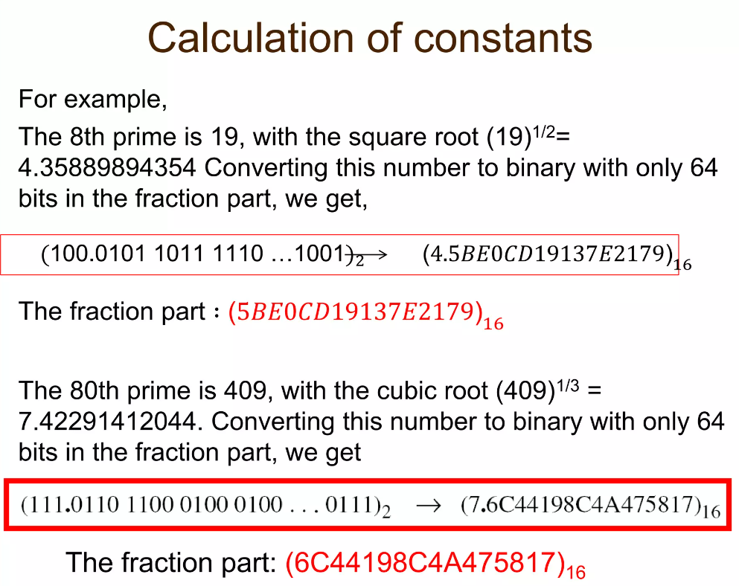

Slide 19
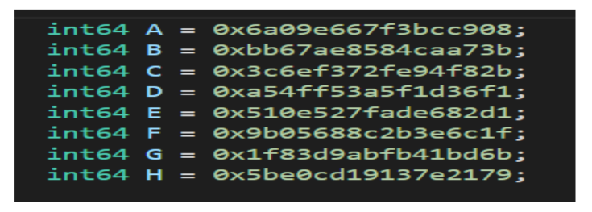

Slide 20
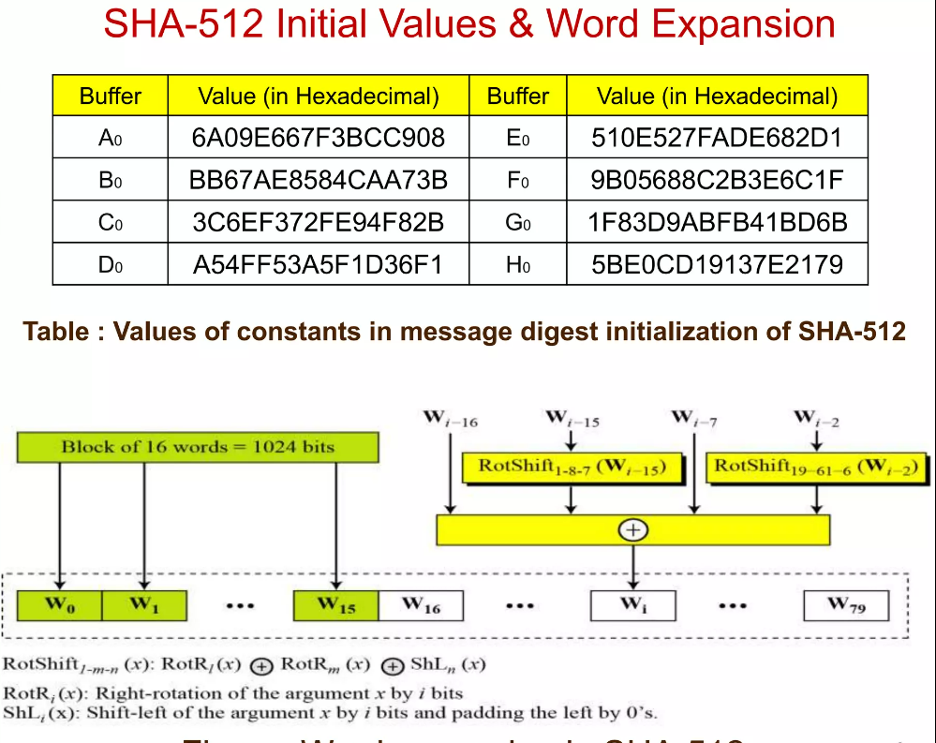

Slide 21
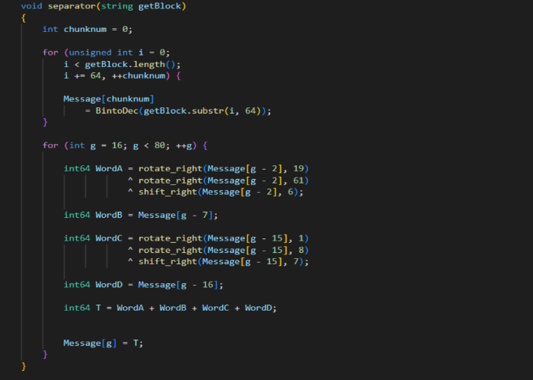

Slide 22
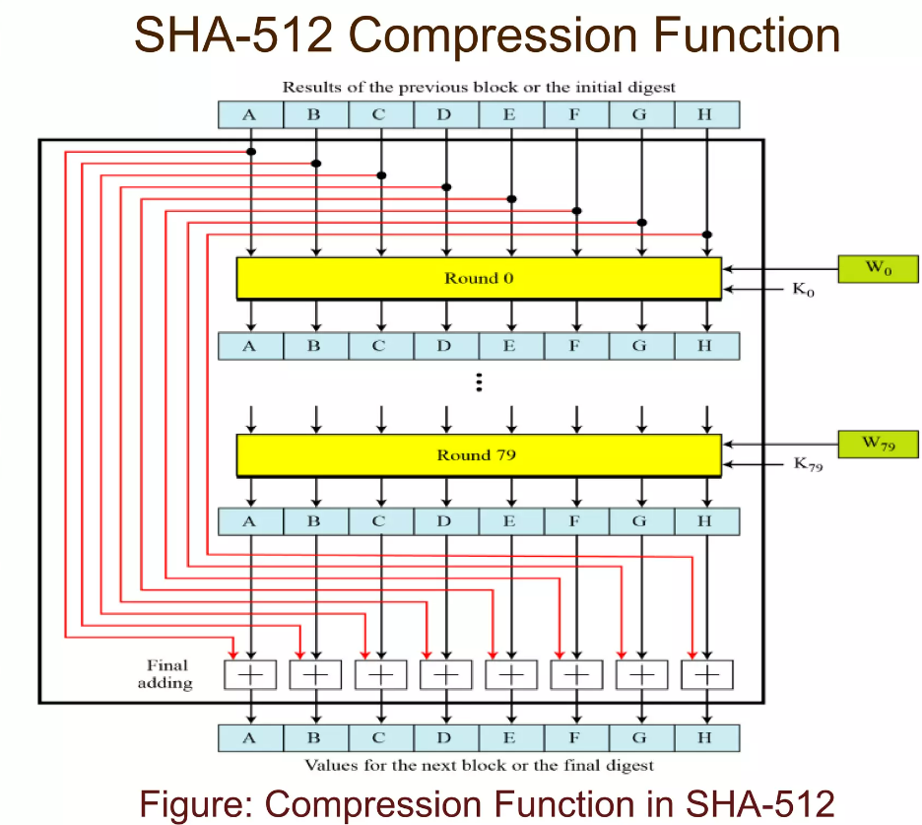

Slide 23
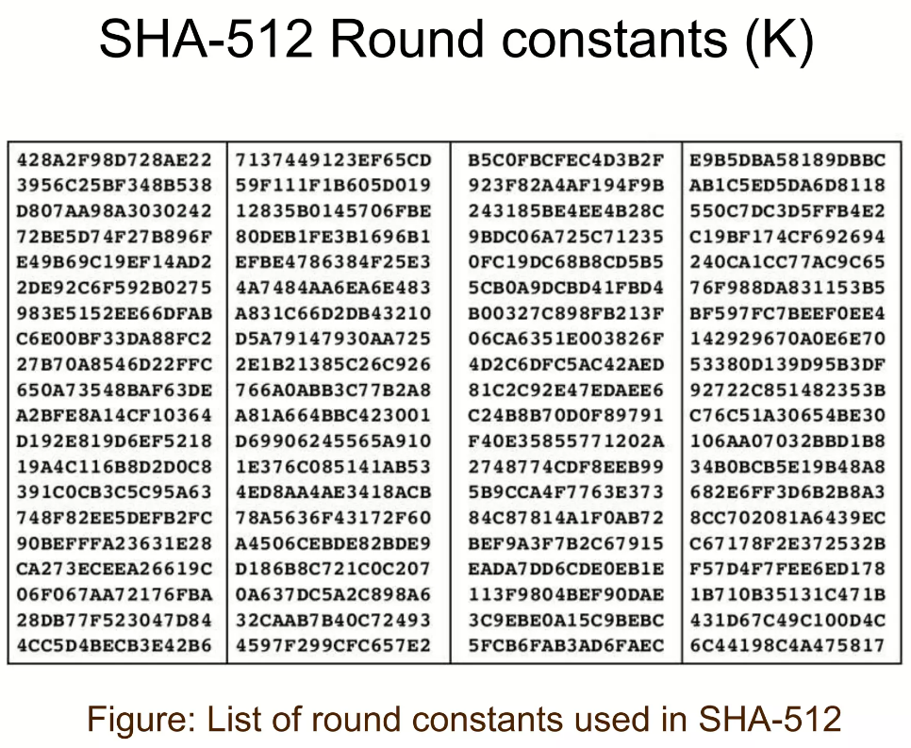

Slide 24
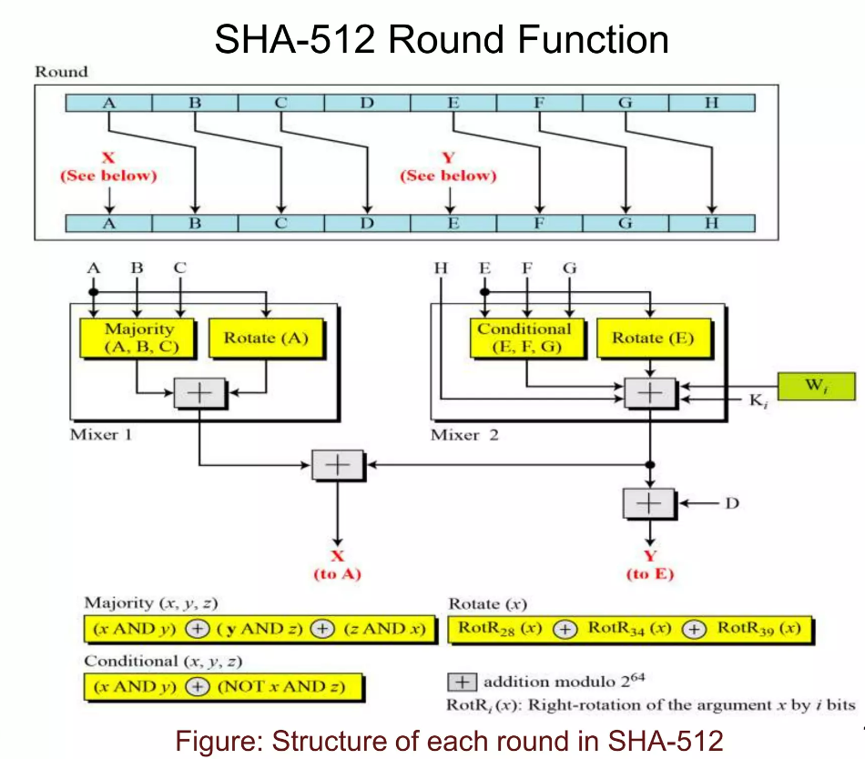
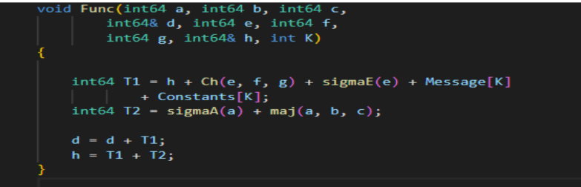

Slide 25
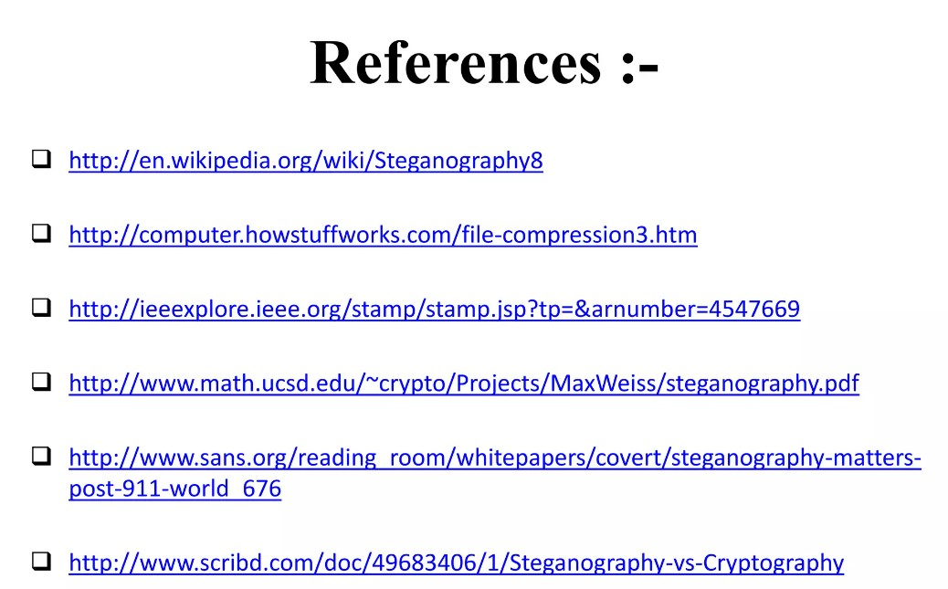

Slide 26
Github - HashStego_Vault

Slide 27
THANK YOU

